Slide 1
Object Oriented Programming Concepts Using C++ & Data Structures

Slide 2
Topics Covered
Data Structures
Array
Stack (Array Implementation)
Queue (Array Implementation)

Slide 3
DS Overview & Why ?
Way of organizing data
Reduce the space and time complexities of different tasks.
High speed in processing
Efficiency of a program
Reusability and Abstraction

Slide 4
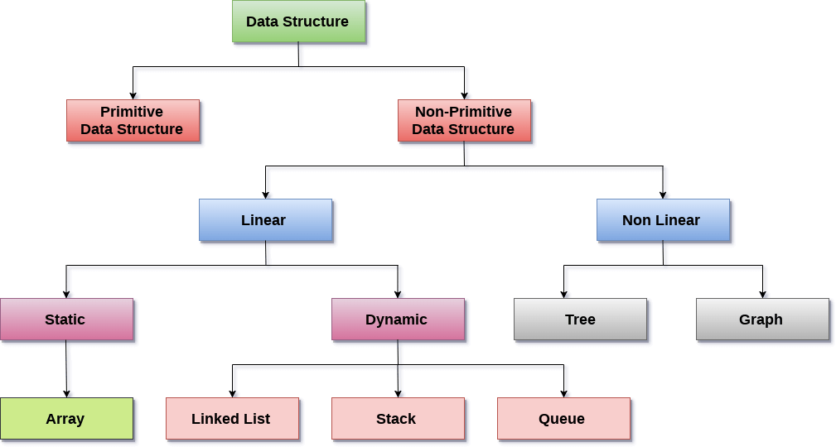
Data Structure Classification

Slide 5
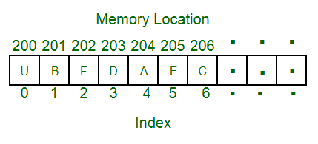
Array
Linear data structure
Elements are stored at contiguous memory locations.
Store multiple items of the same type together
Advantages :
Random access is allowed
Ease of insertion and in Accesss
Drawbacks:
Static memory allocation
Deletion requires Shifting of elements

Slide 6
Array - Accessing Element
accessed using an index number
first element is numbered 0, so that the indices in an array of 10 elements run from 0 to 9.
Complexity : O(1)
temp = myArray[3];

Slide 7
Array - Insertion of Element
Unsorted
Keep track of number of elements in array - nElts
Insert using index and Increment the tracking object
Complexity : O(1)
Sorted
Requires Searching for the position
Shifting the elements to make the specfied position to be vacant.
Complexity : O(N²)
arr[0] = 77
arr[nElts] = 12
nElts = nElts +1

Slide 8
Deletion of Element
Begins with a search for the specified item
When we find it, we move all the items with higher index values down one element to fill in the “hole” left by the deleted element
decrement nElems
for(j=0; j<nElems; j++) // look for it
if(arr[j]== eltToBeDeleted){
for(int k=j; k<nElems; k++) // higher ones down
arr[k] = arr[k+1];
nElems--; // decrement size
break;
}
}

Slide 9
Stack
Linear data structure
New element is added at one end and (top) an element is removed from that end only.
LIFO(Last In First Out) or FILO(First In Last Out).
Example : plates stacked over one another
Can be Implemented using Array or Linked List
Tracking Element : Top
Application :
Processing of subroutine calls and returns
reversing a string
backtracking - Eg :- Maze Game

Slide 10
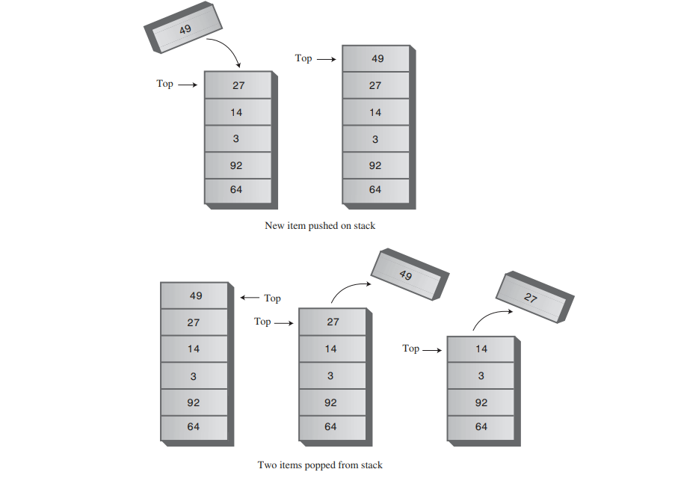
Stack Example

Slide 11
Implementation
class StackX
{
private int maxSize; // size of stack array
private long[] stackArray;
private int top; // top of stack
-------------------------------------------------------
public void StackX(int s) // constructor
{
maxSize = s; // set array size
stackArray = new long[maxSize]; // create array
top = -1; // no items yet
}
-------------------------------------------------------
public void push(long j) // put item on top of stack
{
stackArray[++top] = j; // increment top, insert item
}

Slide 12
Cont.
public long pop() // take item from top of stack
{
return stackArray[top--]; // access item, decrement top
}
-----------------------------------------------------
public long peek() // peek at top of stack
{
return stackArray[top];
}
-------------------------------------------------------
public boolean isEmpty() // true if stack is empty
{
return (top == -1);
}
-------------------------------------------------------
public boolean isFull() // true if stack is full
{
return (top == maxSize-1);
}
-------------------------------------------------------
} // end class StackX

Slide 13
Queue
Linear data structure
New element is added at one end and (rear) an element is removed other end (front).
First In First Out (FIFO)..
Example : Queue for Customer Service
Can be Implemented using Array or Linked List
Tracking Element : Rear and Front
Applications :
Time sharing system
Load Balancing system- Eg:- AWS-SQS, Hold for Tech Support
Print spooling,

Slide 14
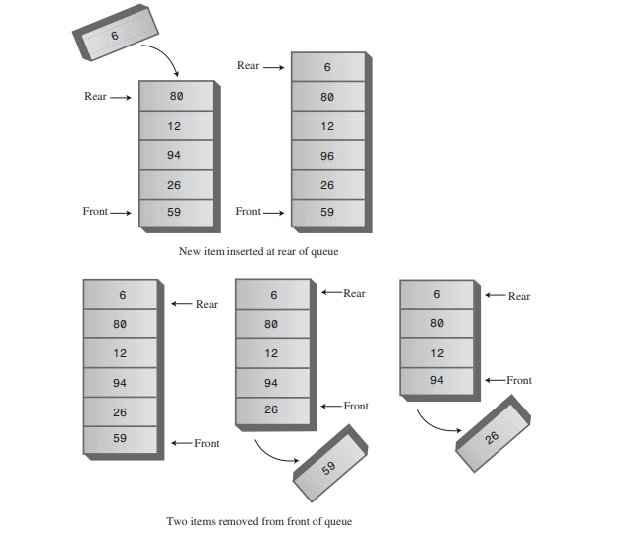
Queue Example

Slide 15
Implementation
class Queue
{
private const int maxSize =10;
private long queArray[maxSize];
private int front;
private int rear;
-----------------------------------------------------
public Queue() // constructor
{
front = -1;
rear = -1;
}
-------------------------------------------------------
public void insert(long d) // put item at rear of queue
{
if(isFull())
cout<<”Queue Overflow”
else {
if (front == - 1)
front = 0; // queue is initially empty queArray[++rear] = d;
}
}

Slide 16
public long remove() // take item from front of queue
{
if(isEmpty()){
cout<<”Queue Underflow”; return 0
}
else {
long temp = queArray[front++];
return temp;
}
}
------------------------------------------------------
public long peek() // peek at front of queue
{
if(isEmpty()) // Queue is empty or not
return 0.0
else
return queArray[front];
}
------------------------------------------------------
public boolean isEmpty() // true if queue is empty
{
return(front == - 1 || front > rear );
}
------------------------------------------------------
public boolean isFull() // true if queue is full
{
return (rear+1==maxSize) );
}
} // end class Queue

